Slide 1

Workforce Solutions
Strengthening WIOA Partnerships

Slide 2
Aligning Resources Through
Strategic Partnerships
Workforce Solutions
Business
CBO’s and Non-Profit Organizations
Advisory Committees & Coalitions
Educational Institutions
Economic Development Corporations

Slide 3

Workforce Services
Workforce

Slide 4
Business Services
  Job Postings
  Hiring Events
  Labor Market Information (job descriptions, wage data, staffing and recruitment plans)
  On-the-Job Training
  Work Experience
  Taskforces
  Information sharing/Business consulting
  Grants

Slide 5
Job Seeker Services
Assistance with Job Search
Job Preparation Classes (i.e. Resume Writing)
Assessments (TABE, Prove It, WIN, CAPS/COPS)
Career Counseling
Job Listing and Referrals
Labor Market Information
Occupational Skills Training
Work Based Learning
  On the Job Training
  Work Experience
Unemployment Insurance Information
Veteran Services

Slide 6
Universal Access to Services under WIOA
Eligibility determination for programs (WIOA Program: Adult, Dislocated Worker and Youth Programs)
Orientation to information and other services available through workforce center
Referrals and coordination of activities with other program and services
Workforce and labor market employment statistic information
Performance information and program costs for eligible training providers by program and provider type
Information regarding availability of support service or assistance, and appropriate referrals

Slide 7
Programs
WIOA (Adult , Dislocated Worker, Youth)
Child Care
Employment Service (ES)*
Temporary Assistance for Needy Family (Choices)
Non-Custodial Parent
Rapid Reemployment Services
Supplemental Nutrition Assistance Program Employment & Training (SNAP E&T)
Trade Adjustment
*Texas Model

Slide 8
Support Services
WFS provides support services as needed to customers to remove barriers from participation.
Note: Support Services are contingent based upon funding availability and eligibility of program participation.
Support services include:
  Child Care Services
  Personal Transportation Services
  Vehicle Related Assistance
  Work Related Expenses
  Training Related Expenses

Slide 9

Gap
Opportunity Gap
Adult Education and Literacy
(Title 2)
Workforce Development
(Title 1 & 3)
Vocational Rehabilitation
(Title4)
Other Services
Training and supportive services
Employment services
Business services
Disability related
services
Veterans services
Public assistance
Other

Slide 10
Leveraging Resources
f
Expertise, Competencies, Skills and Knowledge
Customers
Programs & Services
Resources
Outreach
  Media
  Social Media Platforms
  Partners

Slide 11
Increasing Access through Partnerships
On-Line Service Lists
Joint Outreach
  South Texas College /THECB grants
  Region One ESC (students & teachers)
  Easter Seals
Connection to job opportunities
Connection to new partnerships
  Goodwill Industries
  Rio Grande Regional Hospital
  Raymondville Economic Development Council
  Starr County Self Help Center

Slide 12

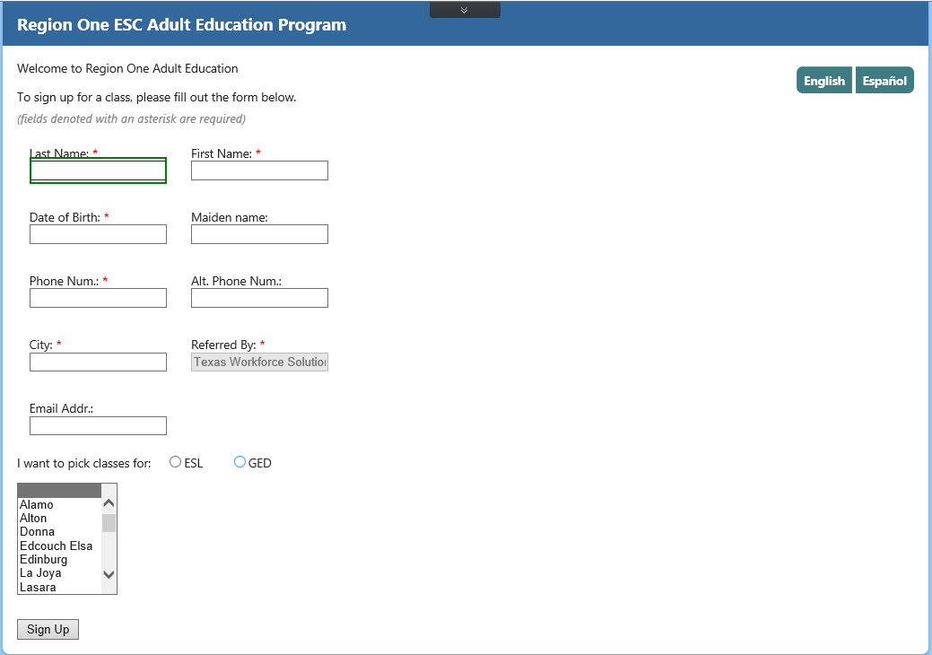
Increasing Connections
WFS Website
Direct link to
Region One
On-line Service Listing Page

Slide 13
Social Media Outreach
Strategies Focused on:
Specific classrooms that needed to maximize student enrollment and attendance and/or to expand class offerings.
Specific sites included the cities
Made available in Spanish and English
Rolled out within 5 calendar days/ 1 city per day

Slide 14
Results of Joint Efforts
Added over 1,800 potential students to existing service lists throughout the three county areas from September 2015 through June 2016.
Critical enrollment months of November, January and March resulted in an increase from an average number of monthly referrals from WFS of approximately 75 potential students to over 400 potential students referred.

Slide 15
Create win-win situations
Executive Leadership Monthly meetings
Identify opportunities and identify strategies
Identify what you can bring to the table
Build Trust
Continuously seek to improve delivery of services
Be outcomes oriented

Slide 16

Questions and Answers

Slide 17


Thank You
Mr. LeeRoy Corkill
Region One Education Service Center
Adult Education Administrator
Office of Adult Education
E-mail: lcorkill@esc1.net
Ms. Arcelia (Shelly) Sanchez
Workforce Solutions-Lower Rio
Planning & Quality Improvement Director
E –mail: shelly@wfsolutions.org
Online: www.wfsolutions.org
Facebook: /WFSolutions

